Slide 1


Lecture 1
Variable &
Vectors / Matrix

Slide 2
What is MATLAB?
MATrix LABoratory
Powerful tool with the integration of computation, programming, visualization & simulation package
Some examples of engineering usages
  Data Acquisition & Analysis
    Bridge Aging Data Acquisition
    Traffic Load/Density Calculation
  Digital Signal Processing
    Amplification/Attenuation of Signal
    Filtering
    Image Processing
  Control System
    Instrument Control
    Simulink Simulation

Slide 3
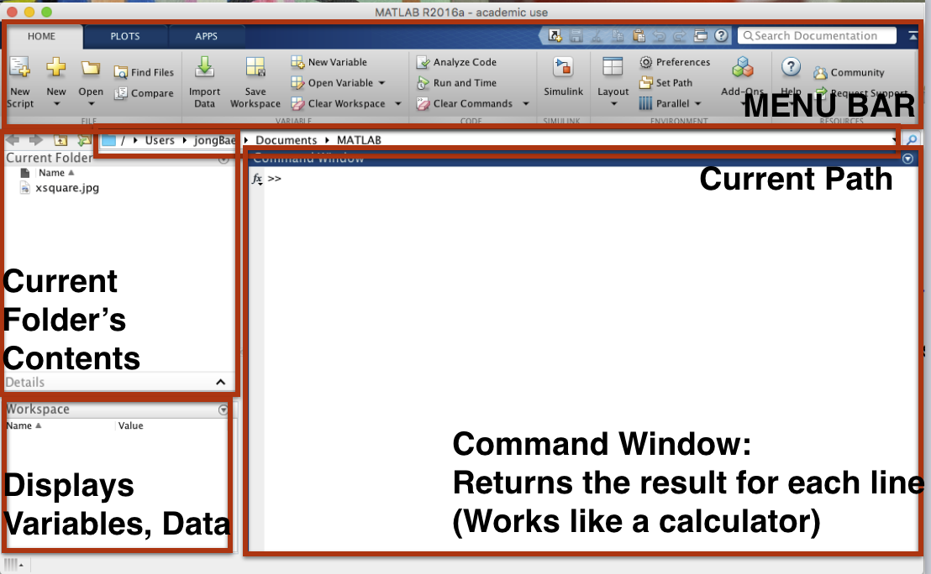
Inside of MATLAB

Slide 4
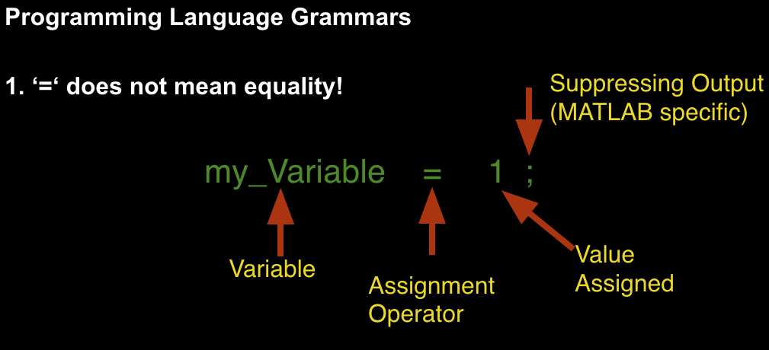
Variable & Data Type

Slide 5
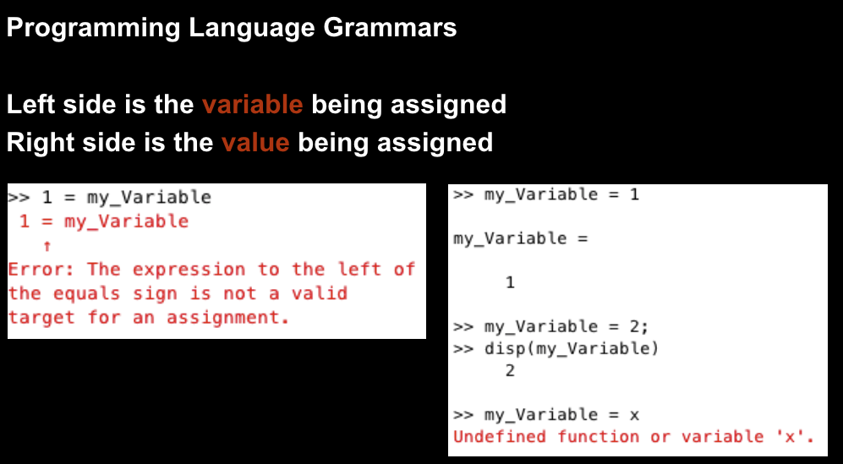
Variable & Data Type

Slide 6
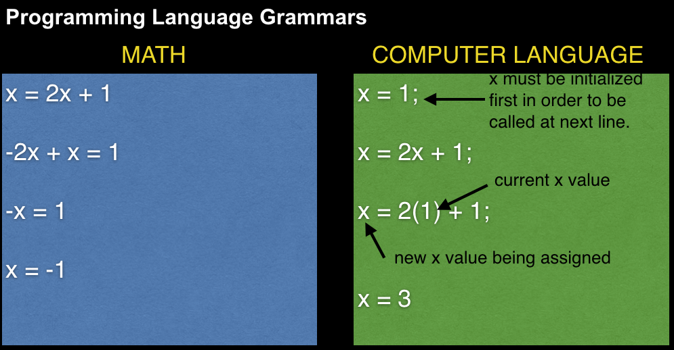
Variable & Data Type

Slide 7
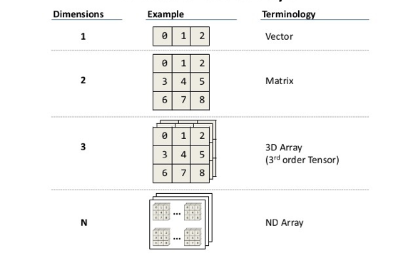
Vector / Matrix

Slide 8
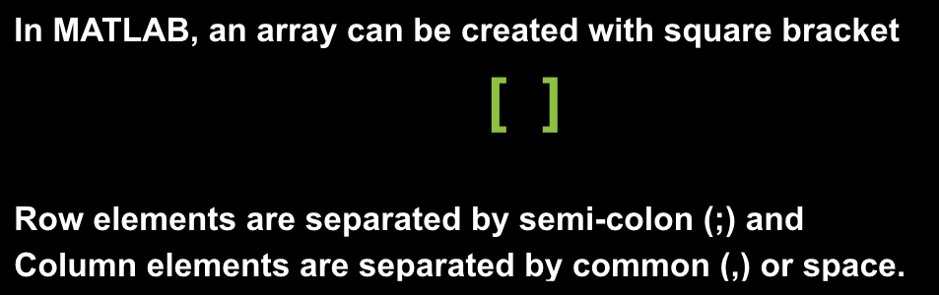
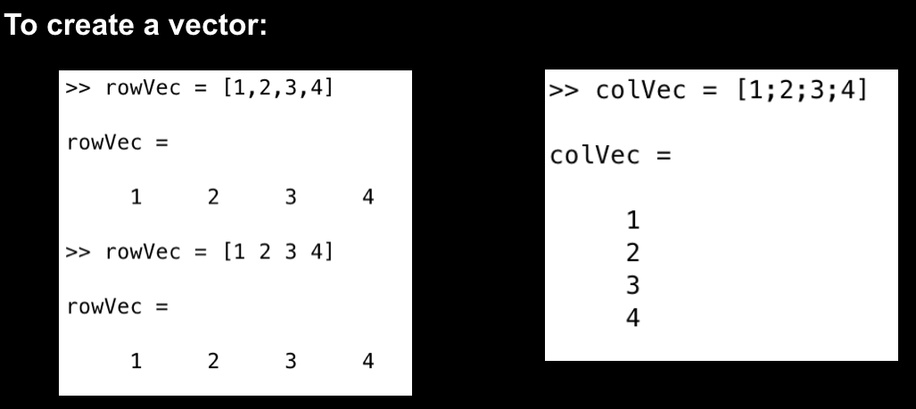
Vector / Matrix

Slide 9
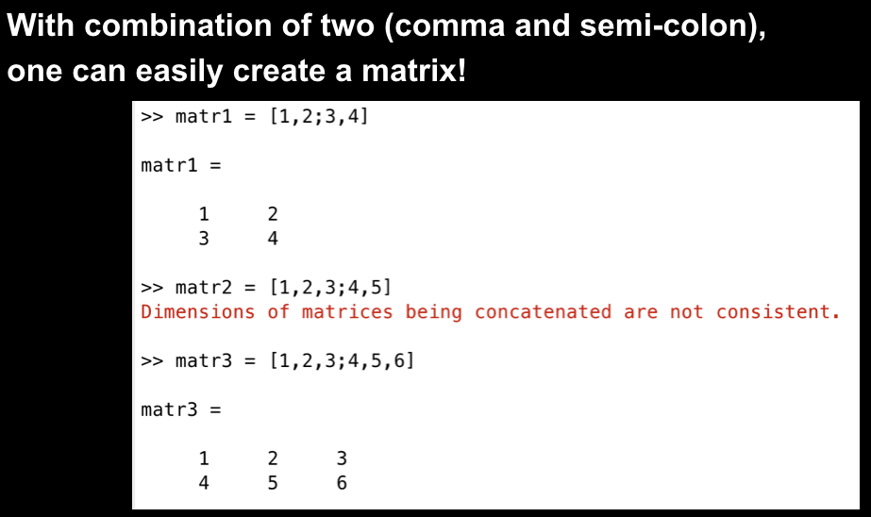
Vector / Matrix

Slide 10
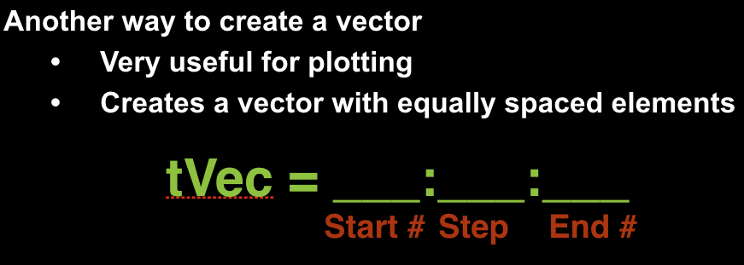
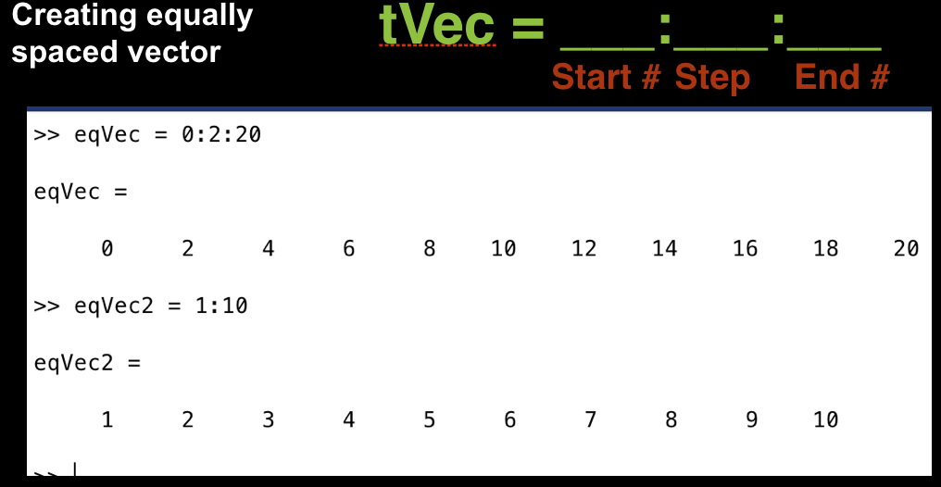
Vector / Matrix

Slide 11
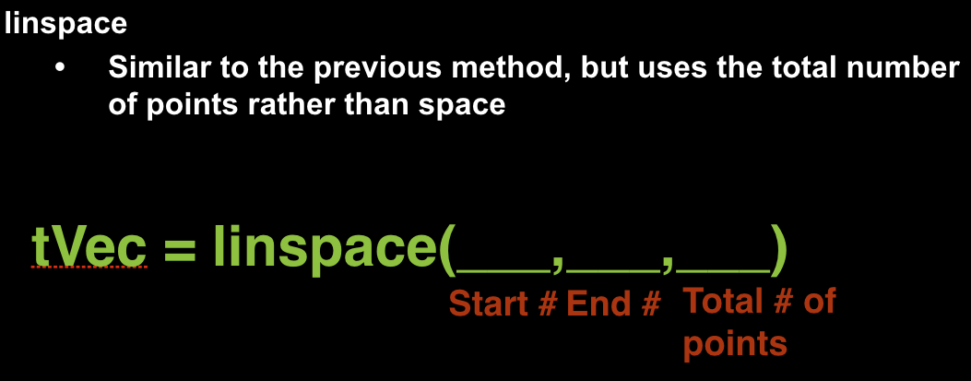
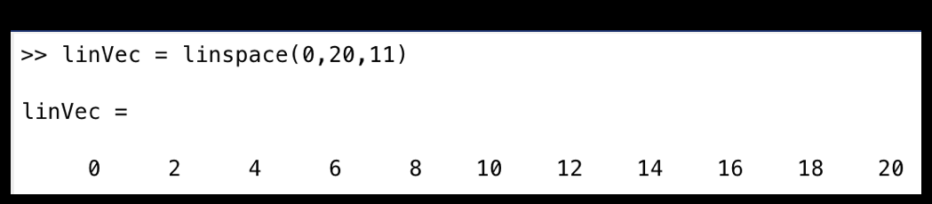
Vector / Matrix

Slide 12
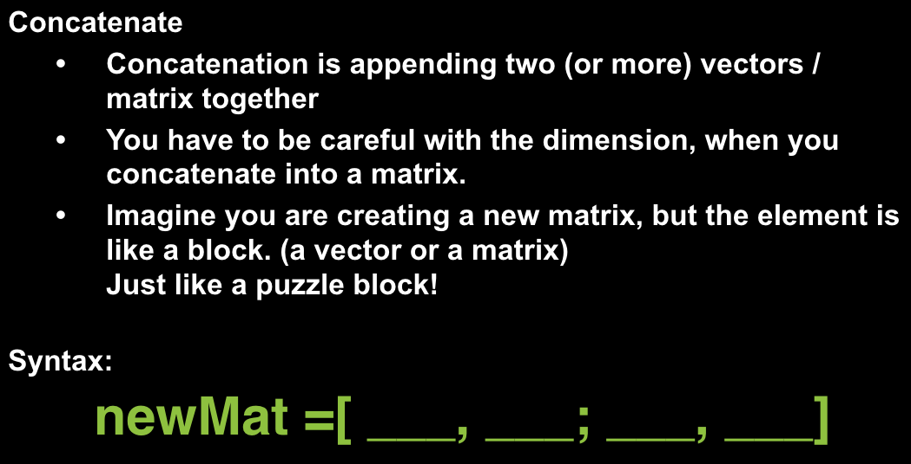
Vector / Matrix

Slide 13
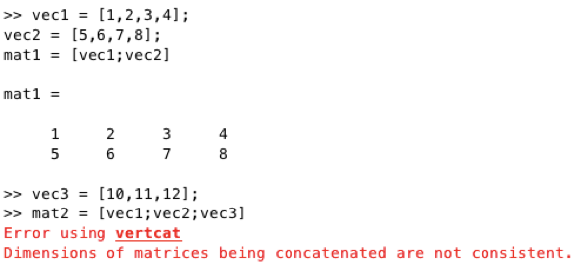
Vector / Matrix

Slide 14
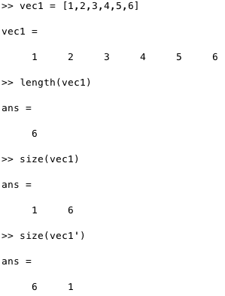
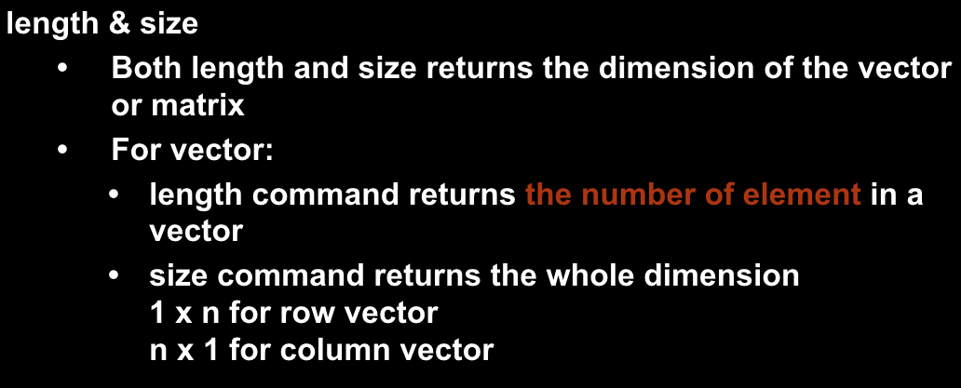
Size of Vector / Matrix

Slide 15
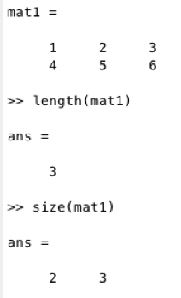
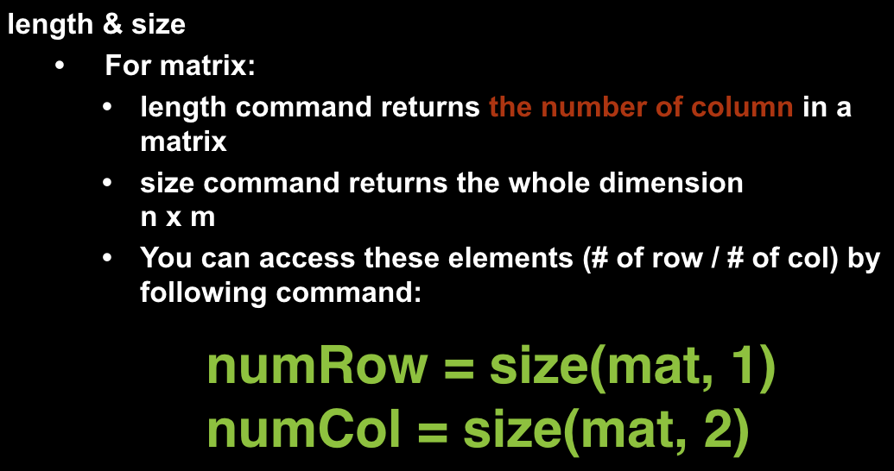
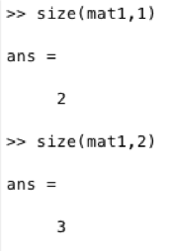
Size of Vector / Matrix

Slide 16
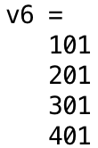

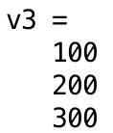



Exercise
Define the following vectors:
Then, concatenate these vectors to form a 4 x 5 matrix
Assign 2 variables num_row and num_col with the number of row and the number of column respectively

